Slide 1
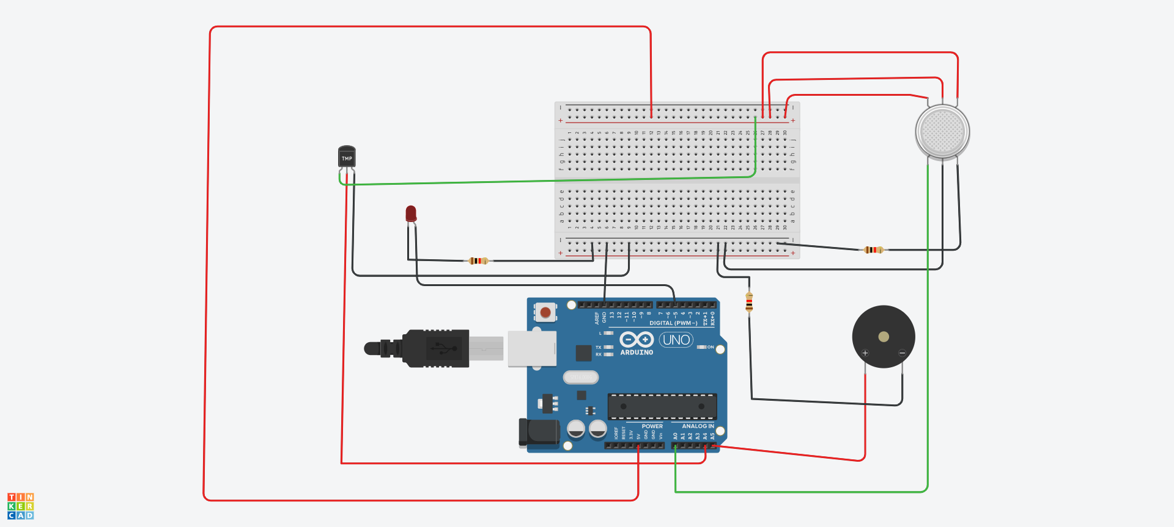

Slide 2
code
int greenled = 5;
int buzzer = A5;
int sensor = A0;
int sensorThresh = 350;
void setup()
{
pinMode(greenled, OUTPUT);
pinMode(buzzer, OUTPUT);
pinMode(sensor,INPUT);
pinMode(A4,INPUT);
Serial.begin(9600);
}
void loop()
{
int value ;
int analogValue = analogRead(sensor);
Serial.print(analogValue);
value=analogRead(A4);
value=value*0.48828125;
Serial.print(value);
if(value>40)
{digitalWrite(buzzer,HIGH);}
else
{digitalWrite(buzzer,LOW);}
if(analogValue>sensorThresh)
{
digitalWrite(greenled,HIGH);
tone(buzzer,1000,100000);
}
else
{
digitalWrite(greenled,LOW);
noTone(buzzer);
}
}

Slide 3
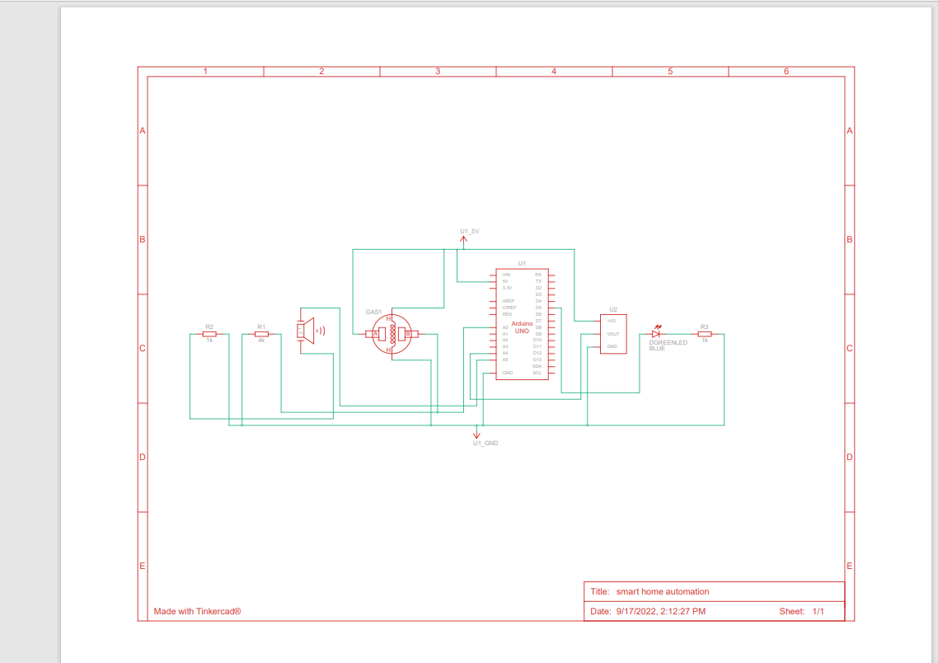

Slide 4
